Slide 1
Children with intellectual disabilities and children with autism in Scottish schools Lisa O’Leary, Angela Henderson, Myrthe Jacobs, Sally-Ann Cooper

Slide 2
Background
People with intellectual disabilities and people with
autism experience health inequalities across the life course
These health inequalities start early in life. For example children with intellectual disabilities, and children with autism are at risk of higher rates of obesity (Emerson & Robertson, 2010; Curtin et al. 2014)
Education can influence these health inequalities (Public Health England, 2012)

Slide 3
Practical drivers
Need to understand the individual characteristics and social contextual factors that influence the lives of children and young people with intellectual disabilities and/or autism
Need to plan and implement early interventions for pupils with autism and pupils with intellectual disabilities
Need to support future service planning for these populations

Slide 4
Policy drivers in Scotland
Notes:
Keys to life recommendation 39 : Develop informed transition planning
to report on the impact of implementation of the Children and Young Peoples’ Act for people in these population groups.
This GIFERC which is centrede on Getting it right for every child centres on improving, focuses on the responsiveness of services for the needs of chidlren

Slide 5
1. What is the reported prevalence rate for intellectual disabilities and autism among pupils in Scotland? 2. What are the trends in this reported prevalence rate over time in Scotland? 3. What are the demographics and characteristics of pupils with intellectual disabilities and autism in Scotland?
Aims

Slide 6
Methods
Secondary descriptive analysis of data from the Scottish Pupil Census: Years 2008-2015

Slide 7
The Scottish Pupil Census data source
Includes all publically funded, primary, secondary and special schools in Scotland
Includes pupils aged 4.5-19 years
Primary schools: 7 years: Secondary schools: 6 years
Provides information on additional support needs
Changes in how additional support was recorded post
2006
Reliable coding of intellectual disability and autism data from 2008
Notes:
The Pupil Census in Scotland is carried out on a yearly basis in September (Scottish Government, 2015). The information is collected electronically from schools’ management information systems through the ScotXed programme. ScotXed ensures that data exchanges are effective and secure

Slide 8
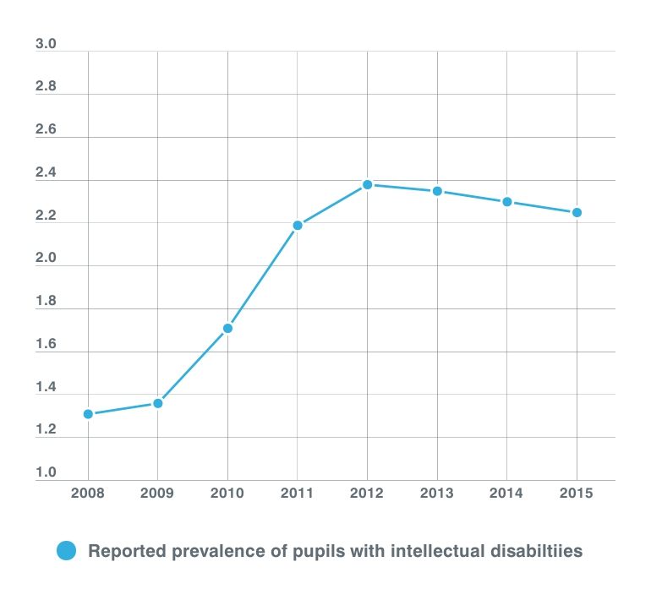
Reported prevalence of pupils with intellectual disabilities
2.38%
2.35%
2.3%
2.25%
2.19%
1.71%
1.36%
1.31%

Slide 9
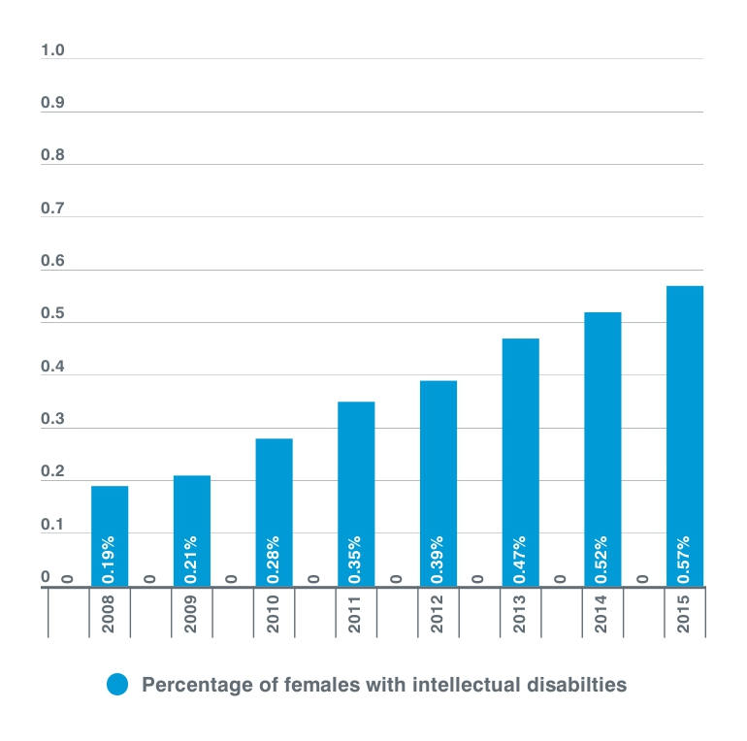
Reported prevalence of females pupils with
intellectual disabilities
Notes:
You can see from the graph that there was a slight increase in reports of females with intellectual disabilites over time, and a slight reduction in males

Slide 10
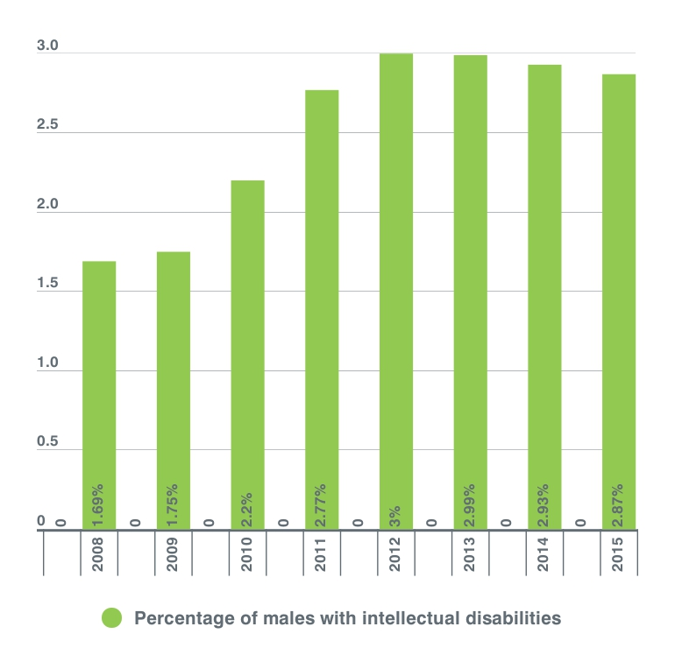
Reported prevalence of
male pupils with
intellectual disabilities
Reported prevalence of pupils with intellectual disabilities for females

Slide 11
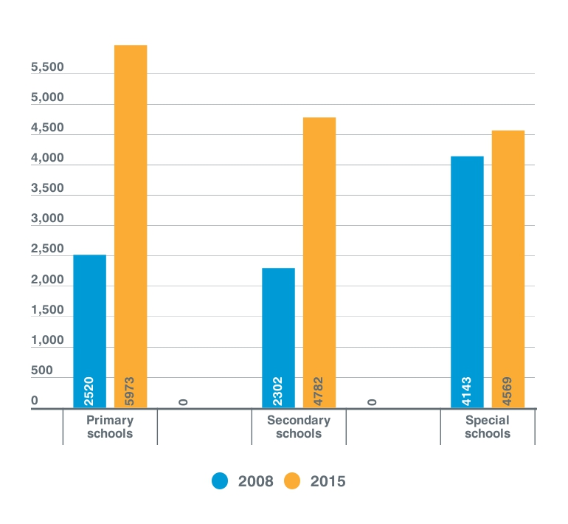
Prevalence of intellectual disabilities by different schools over time
Notes:
Increase in prevalence of pupils with intellectual disabilities in mainstream education (primary and secondary school), reduction in special schools
53.84% in mainstream education in 2008
70.19% in mainstream education 2015

Slide 12
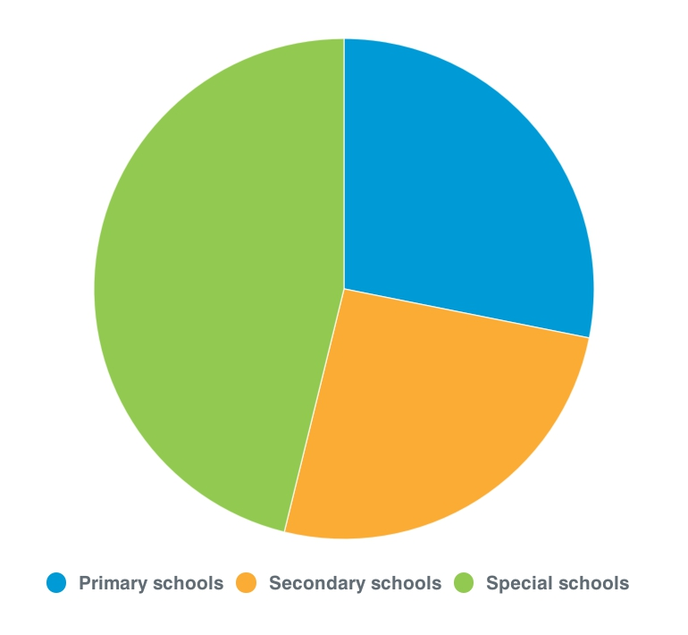
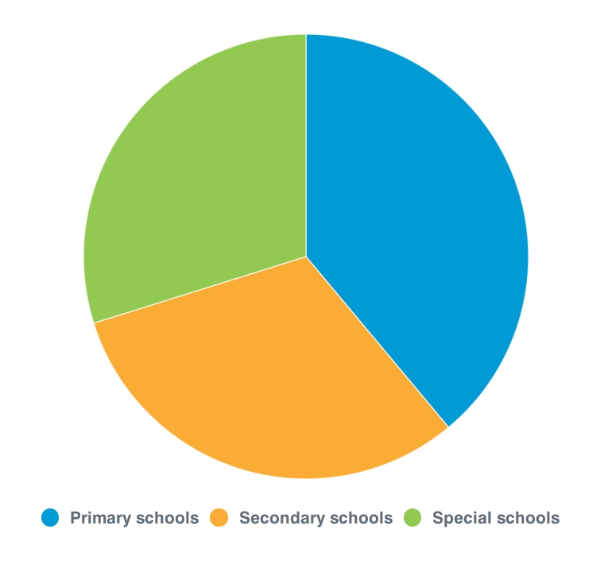
Prevalence of intellectual disabilities by different schools over time
School trends in 2008
School trends in 2015
28.14%
29.82%
38.98%
46.16%
46.16%
25.7%
31.21%
Notes:
Increase in prevalence of pupils with intellectual disabilities in mainstream education (primary and secondary school), reduction in special schools
53.84% in mainstream education in 2008
70.19% in mainstream education 2015

Slide 13
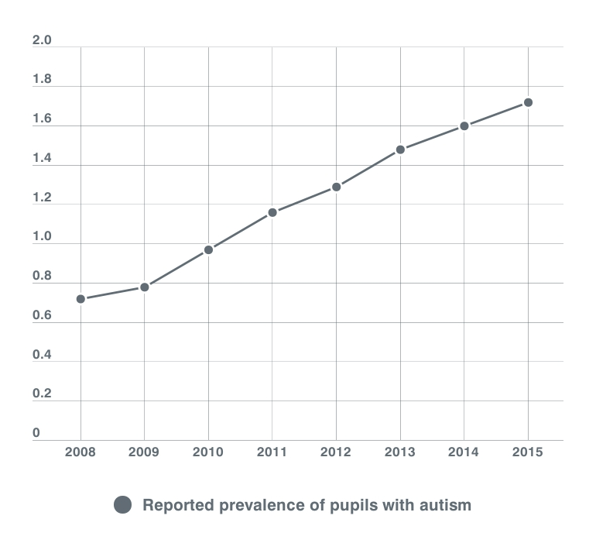
Reported prevalence of pupils with autism over time
1.72%
1.6%
1.48%
1.29%
1.16%
0.97%
0.78%
0.72%

Slide 14
Reported prevalence of female pupils with autism
Gender of pupils with
Gender of pupils with intellectual disabilities over time
Notes:
More males than females are identified as having ASD. In 2015, 83.68% of pupils with ASD were male and 16.32% were female. These proportions have been similar since 2008, although a slight increase in the proportion of females can be seen up until 2015.

Slide 15
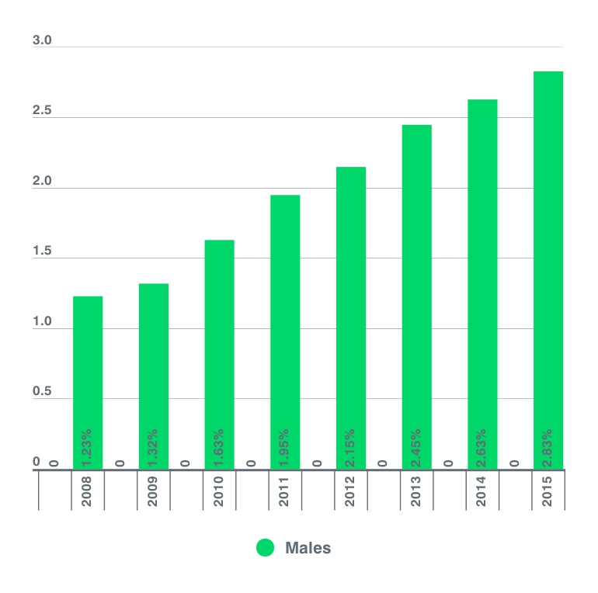
Reported prevalence of males pupils with autism

Slide 16
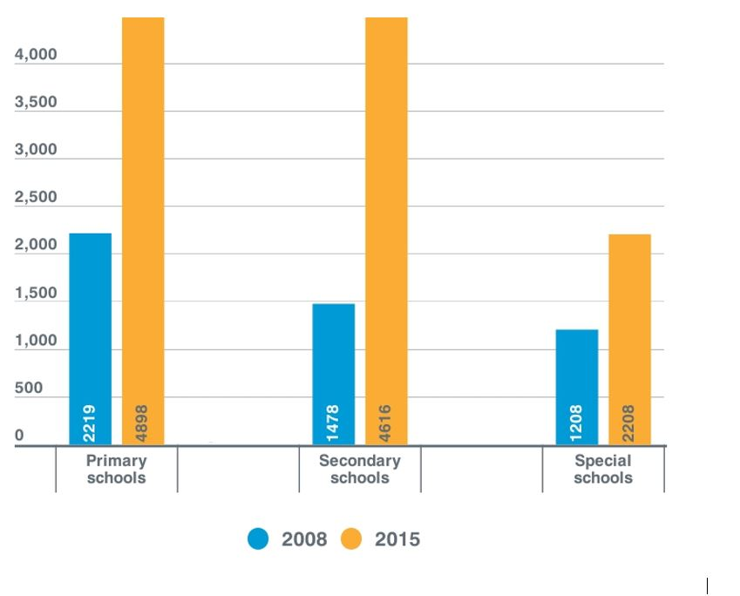
Prevalence of intellectual disabilities by different schools over time
Prevalence of autism by different schools over time

Slide 17
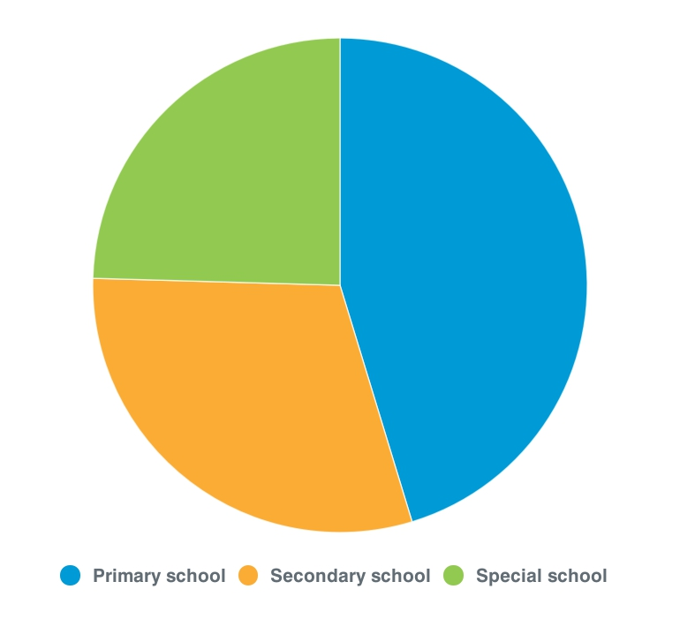
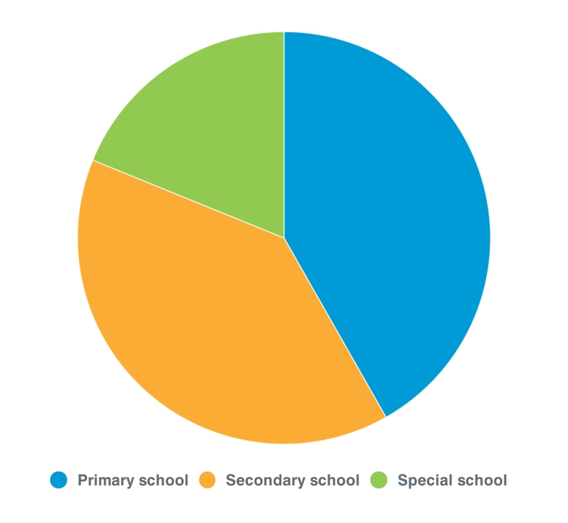
Prevalence of intellectual disabilities by different schools over time
Prevalence of autism by different schools over time
School trends in 2008
School trends in 2015
24.55%
18.84%
45.29%
41.78%
30.16%
39.38%

Slide 18
Overall pupil trends in Scotland: 2008-2015
Increased reports of pupils with autism from 2008-2015
Increased reports of pupils with intellectual disabilities from 2008-2012
Increased reports of pupils with intellectual disabilities in
mainstream schools
Increased reports of pupils with autism in secondary
schools

Slide 19
Limitations and implications of findings so far
Limitations of proxy reported data collected in census
Level of intellectual disability not provide in census
Restricted to publically funded schools
Need to collect more detailed information about the characteristics of pupils
Overall trends for pupils with autism in Scotland: 2008-2015
Notes:
Perce

Slide 20
Future directions
The SLDO team plan to undertake further exploration of the Scottish Pupil Census

Slide 21
Thank you!
www.sldo.ac.uk
@scotLDO

