Slide 1
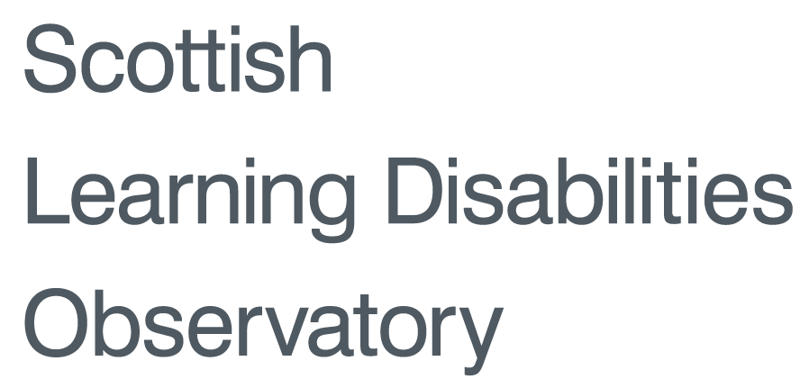
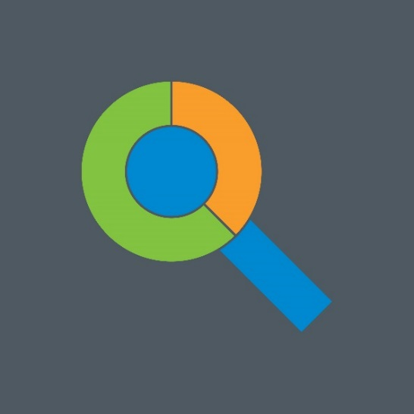
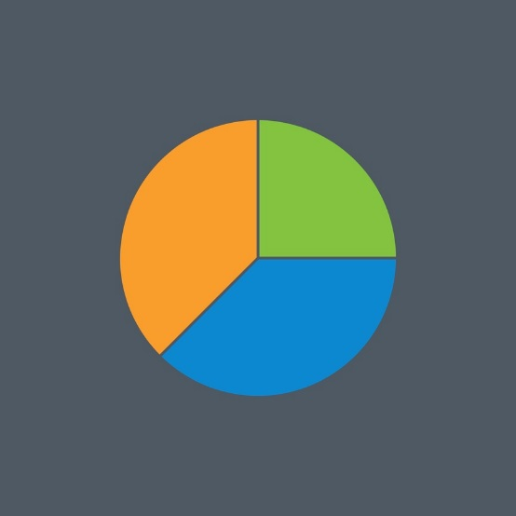
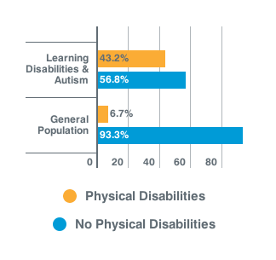
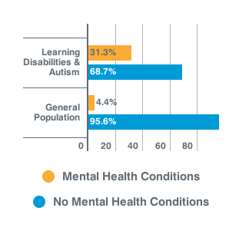
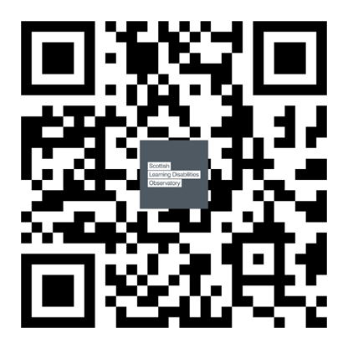
The physical and mental health of people with comorbid autism and learning disabilities in Scotland
Kirsty Dunn, Ewelina Rydzewska, Laura Anne Hughes-McCormack, Angela Henderson, Sally-Ann Cooper
Institute of Health and Wellbeing, University of Glasgow
k.dunn.1@research.gla.ac.uk
Introduction
Little is known about the physical or mental health status of people with comorbid autism and learning disabilities in whole country populations
Project Aims
This study aimed to investigate:
Prevalence of mental health conditions
Prevalence of physical disabilities
Prevalence of other disabilities
Impact of conditions on daily activities
Methods
We analysed Scotland's Census 2011 data, and generated descriptive statistics about people with comorbid autism and learning disabilities, compared with the general population
Sample
People with learning disabilities & autism in Scotland (n=5,709) comprised:
N=5,295,403 (0.1%) of the total population of Scotland,
N=31,712 (18.0%) of the whole population of people with autism in Scotland,
N= 26,349 (21.7%) of the whole population of people with learning disabilities in Scotland across all ages
Results
Proportion with Physical Disabilities
Proportion with Mental Health Conditions
Other long-term illnesses or diseases
49.6% Learning disabilities & autism
18.6% General population
Day-to-day activities limited because of long-term health problem or disability
73.1% Activities limited a lot compared with 9.5% of the general population
17.5% Activities limited a little compared with 10.1% of the general population
9.4% Activities not limited compared with 80.4% of the general population
Conclusions
Health is poorer for people with comorbid autism and learning disabilities than for people in the general population.
They are more likely to:
Report physical and mental health problems,
Report long term illnesses,
Experience more resultant limitations on their daily activities.
The Scottish Learning Disabilities Observatory is conducting further analysis on data from Scotland's 2011 Census

