Slide 1






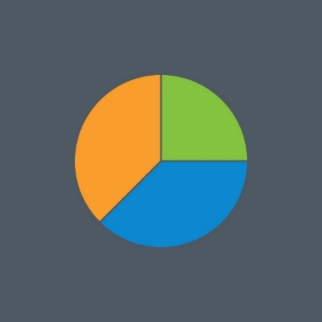


Trends in the expenditure on adult learning disabilities services across Scottish health boards and local authorities
Ms Marian Okon, Mrs Angela Henderson & Professor Sally-Ann Cooper
Institute of Health and Wellbeing, University of Glasgow
Marian.Okon@glasgow.ac.uk
www.sldo.ac.uk
Introduction
Between 2010/11 and 2014/15, there has been a decrease in health budgets and government funding for councils in Scotland have decreased ^{1,2}
Reduced spending has been accompanied by changes in the structure of health and social care delivery ³
However, there is a dearth of information on variation and trends in expenditure on adult learning disabilities services across Scotland
Methods
Secondary data analysis
Expenditure data for 2012/13, 2013/14 and 2014/15 on adult learning disabilities services in Scotland
Data obtained from Scottish Local Government Financial Statistics and the Scottish Health Service Costs
Project Aim
To examine the variation and trends in the expenditure on adult learning disabilities services across Scotland
Results
Is there variation in expenditure patterns for adult learning disabilities services across Health Boards, per capita general population?
Is there variation in expenditure patterns for adult learning disabilities services across Local Authorities, per capita general population?
NHS Fife, NHS Greater Glasgow & Clyde and NHS Dumfries & Galloway are the highest spenders on adult learning disabilities services
NHS Highland, NHS Orkney and NHS Shetland are the least spenders on adult learning disabilities services
There are no consistent trends over the 3 years
Some Boards have progressively spent less – Greater Glasgow & Clyde, Fife (both high spenders per capita)
Some Boards have progressively spent more – Dumfries & Galloway (also a high spender per capita), Tayside
Shetland Islands, Aberdeenshire, Argyll & Bute and Fife are the highest spending local authorities on adult learning disabilities services
Angus, Glasgow City and Inverclyde are the least spending local authorities
There are no consistent trends over the 3 years
Some Authorities have progressively spent less – Glasgow City, Inverclyde, Scottish Borders
Some Authorities have progressively spent more – Dundee City, Eilean Siar, Falkirk
Conclusions
There are no consistent trends over time in expenditure across Scotland
This study has reported the variation in the expenditure on adult learning disabilities services across Scotland
References
1. Audit Scotland. (2015a). An overview of local government in Scotland 2015. Online at: http://www.audit-scotland.gov.uk/docs/local/2015/nr_150305_local_government_overview.pdf
2. Audit Scotland. (2015b). NHS in Scotland 2015. Online at: http://www.audit-scotland.gov.uk/uploads/docs/report/2015/nr_151022_nhs_overview.pdf
3. Cooper S. A., Henderson A., Jacobs M. & Smiley E. (2016). What Are Learning Disabilities? How Common Are Learning Disabilities? Scottish Learning Disabilities Observatory

