Slide 1






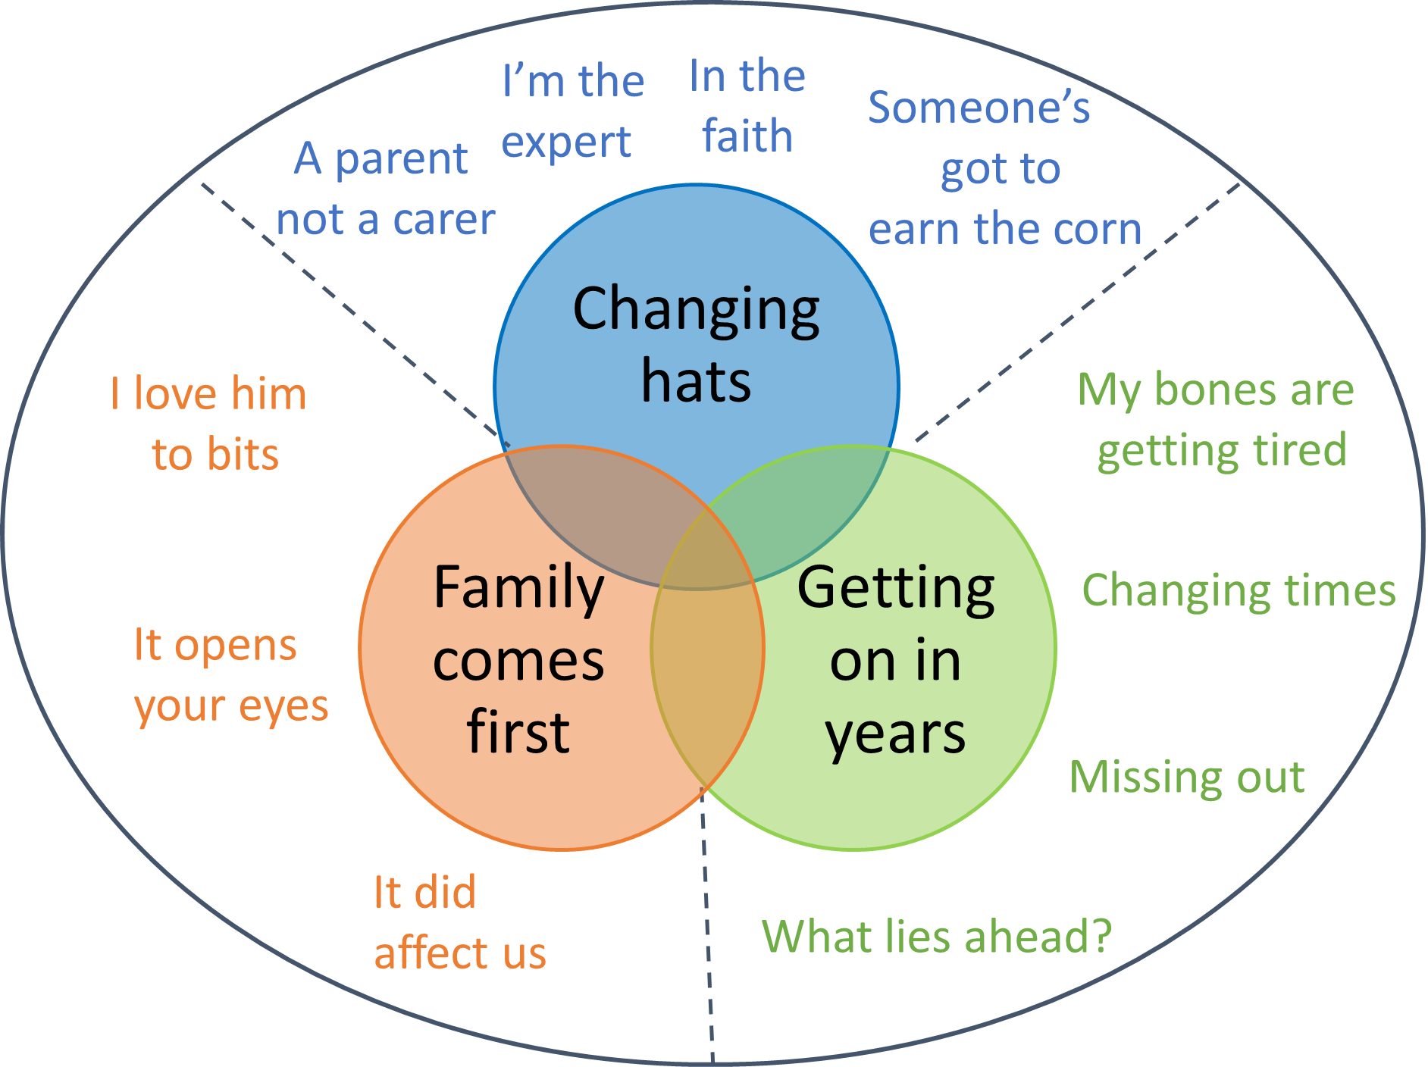



Older fathers’ perspectives on caring for a son or daughter with intellectual disabilities
Mrs Kirsty Dunn, Dr Deborah Kinnear, Professor Andrew Jahoda
University of Glasgow, Institute of Health and Wellbeing
Introduction
As life expectancy for people with intellectual disabilities increases, there is a growing cohort of older father carers (Cairns et al, 2013). Previous research into the experiences of older parents has largely focussed on mothers, resulting in a dearth of studies on fathers and therefore little understanding of fathers’ experiences of caring into older age (Gore, 2010). As older father carers are a growing cohort, it is important to investigate the impact of caring on this population. This study aimed to gain a more in-depth understanding of older father carers’ experiences of caregiving.
Methods
Semi‐structured interviews were conducted with 7 older fathers (Mean age= 63.9 years) recruited from charitable organisations providing services to people with intellectual disabilities and their families. Interviews were audio-recorded and transcribed verbatim. Transcripts were analysed using Constructivist Grounded Theory (Charmaz, 2006).
Results
The core component of the theoretical model is:
‘life through a different lens’, which addresses how older fathers’ lives, world view, and future have been impacted by their child with intellectual disabilities.
Three conceptual categories were identified:
‘Changing hats’ - fathers’ sense of identity had altered over the years
‘Family comes first’ - the importance fathers placed on the family unit
‘Getting on in years’ - the challenges of ageing while caring
Master theme | Sub-theme | Supporting quote
Changing hats | A parent not a carer | “I would say we don’t see it as being carers. Carers are somebody else. That’s not us, you know? We’re just her parents.” (Mr Walker)
 | I’m the expert | “So, I’m actually getting phone calls from other families ’My son’s just leaving schools Larry, what would you advise?’ I’m saying well ‘don’t do this, don’t do that, don’t do this, don’t do that’. And I get a great deal of, sort of satisfaction from doing that.” (Mr Kendall)
 | In the faith | “So, we’ve not thrown ourselves into the Down Syndrome charities, as some people do. That just …. I think part of that is because our big involvement was with another community, it was the church community. And that community fulfilled not just some of our needs and interests, but also the families.” (Mr Murphy)
 | Someone’s got to earn the corn | “… and whilst I was there as much as I could be for Laura, somebody’s got to go out and earn the corn.” (Mr Thomson)
Family comes first | I love him to bits | “I think I just like him the way he is now. All his little idiosyncrasies shall we say. He’s my son and I love him to bits.” (Mr Kendall)
 | It opens your eyes | “In the past, before Jessica, you see people with disabilities and you just (shrug) ‘It’s just a disability’ but now when I see somebody with a disability I wonder how they’re getting on.” (Mr McKay)
 | It did affect us | “Mark is Mark, and Mark has enriched our family in a way that would never have happened had he not been Mark. So, it’s not a …. It can never be, I suppose is what I’m saying... it can never be a regret, it can never be a regret.” (Mr Murphy)
Getting on in years | My bones are getting tired | “As she got older I refused to consider myself getting older and it took me a long while to start using the hoist and things that were provided. But I realised, after a few problems with health wise, that meant I better start using the hoist.” (Mr McKay)
 | Changing times | “… but that’s what it was like in those days. Well that’s it, just get on with it. No support, no nothing.” (Mr Lampton)
 | Missing out | “I’ve had my moments where I’ve said ‘Why me?’ When my mates are all off to a golf weekend and I can’t go. Or off to a stag weekend and I can’t go on a stag weekend.” (Mr Kendall)
 | What lies ahead? | “…but again, there’s not a lot you can do about it. You can only put things in place. We’ve tried to put things in place, financial wise and different things and what have you.” (Mr Walker)
Conclusions
Results from this study demonstrate the high value that older fathers place upon their relationship with their child, and the ways in which they perceive parenting a child with intellectual disabilities to have led to personal growth for both themselves and their family. Becoming an expert in the social care system was found to positively impact fathers’ wellbeing and give unemployed fathers a new sense of purpose. This suggests that fathers would benefit from services interacting with them and providing them with more information about the social care system as well as how to care for their child with intellectual disabilities.
References
Cairns, D., Tolson, D., Brown, J., & Darbyshire, C. (2013) The need for future alternatives: an investigation of the experiences and future of older parents caring for offspring with learning disabilities over a prolonged period of time. British journal of learning disabilities, 41(1), 73-82.
Charmaz, K. (2006). Constructing grounded theory: a practical guide through qualitative research. London: Sage.
Gore, N. (2010) Support for fathers of learning disabled children. Community Care, 11 (1809), 24-25.

