Slide 1
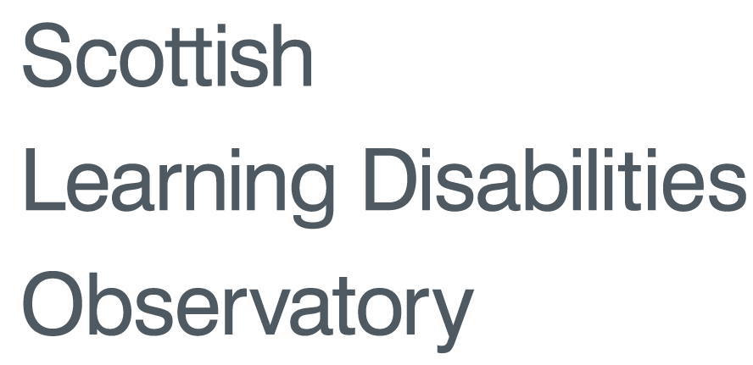
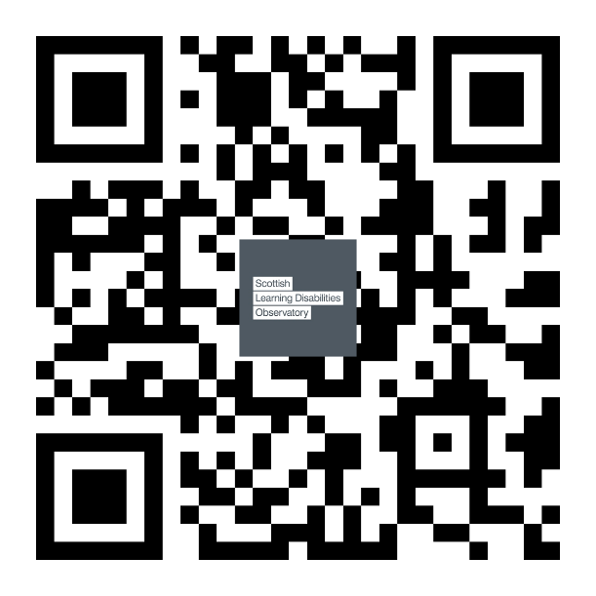
Prevalence of comorbid health conditions in autism
Findings from a national census study
Ewelina Rydzewska¹, Laura Anne Hughes-McCormack¹, Christopher Gillberg¹, Angela Henderson¹, Cecilia MacIntyre², Julie Rintoul², Sally-Ann Cooper¹
¹University of Glasgow, Institute of Health and Wellbeing
²Scottish Government
ewelina.rydzewska@glasgow.ac.uk
Introduction
Existing research on autism reports on a range of comorbid conditions. However, little is known about prevalence rates of comorbid health conditions in autism in whole country populations.
Project Aims
For the populations with and without autism in the whole of Scotland, this study aimed to investigate:
prevalence and number of comorbid health conditions
investigate the odds ratios of comorbid health conditions.
Methods
We used Scotland’s 2011 Census data to calculate how many people with and without autism reported to have visual and hearing impairments, intellectual disabilities, mental health problems, physical disabilities, and other conditions. We compared differences using chi-square tests. We then calculated odds ratios (95% CI) for comorbidities in autism.
Sample
In total, 5,295,403 people lived in Scotland in 2011
31,712 (0.6%) of them have autism
That’s 24,490 (1.0%) males and 7,222 (0.3%) females
17,348 (1.9%) children and 14,364 (0.3%) adults
 | Total N(%) | 0-15 yrs | 16-24 yrs | 25-34 yrs | 35-44 yrs | 45-54 yrs | 55-64 yrs | 65+ yrs
People with autism | 31,712 (0.6%) | 17,348 (1.9%) | 7,715 (1.2%) | 2,389 (0.4%) | 1,588 (0.2%) | 1,267 (0.2%) | 707 (0.1%) | 698 (0.1%)
People without autism | 5,263,691 (99.4%) | 898,983 (98.1%) | 624,773 (98.8%) | 664,938 (99.6%) | 733,166 (99.8%) | 785,489 (99.8%) | 666,706 (99.9%) | 889,636 (99.9%)
Results
Prevalence of comorbidities by age
Prevalence of comorbidities by gender
Number of conditions by gender
People with autism
People without autism
Number of conditions by age
Conclusions
People with autism are more likely to:
have other comorbidities, especially intellectual disabilities and mental health problems
have 3 or more long-term health conditions, especially females
More information:
www.sldo.ac.uk
This poster presents findings from Scotland’s Census 2011. If you have an enquiry that specifically relates to Scotland’s Census 2011, please contact National Records of Scotland Customer Services
at customer@gro-scotland.gsi.gov.uk or visit www.scotlandcensus.gov.uk.

