Slide 1
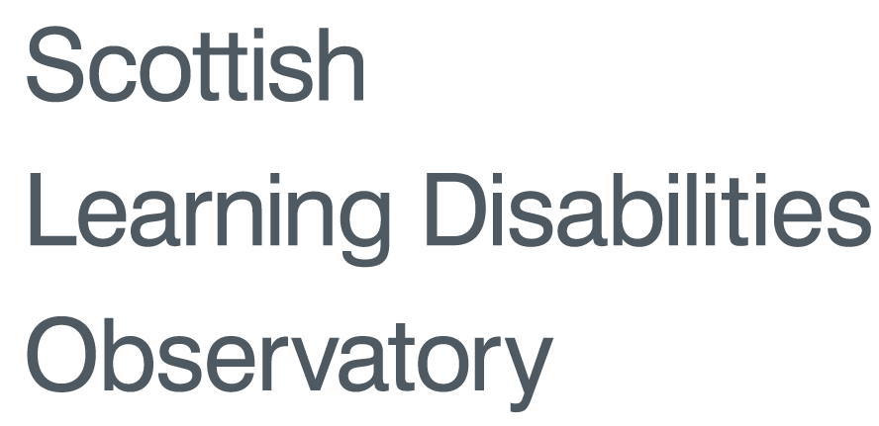
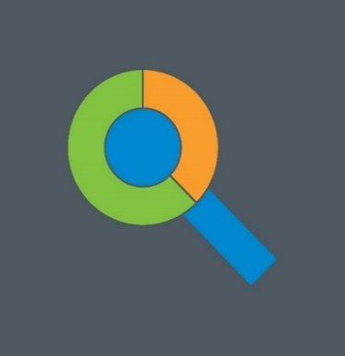
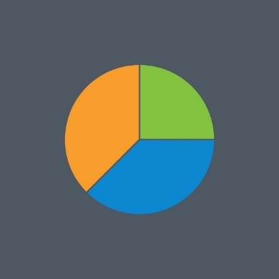
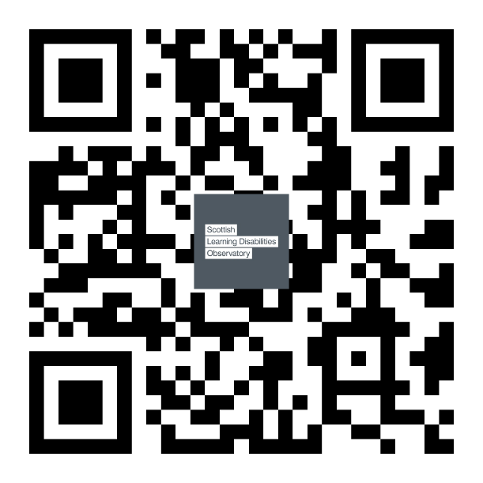
Prevalence and general health status of people with learning disabilities
in Scotland: a total population study
Laura Anne Hughes-McCormack, Ewelina Rydzewska, Angela Henderson, Sally-Ann Cooper Institute of Health and Wellbeing, University of Glasgow
Laura.Hughes-McCormack@glasgow.ac.uk
Introduction
People with learning disabilities experience health inequalities compared to other people ¹⁻⁵
Very little is known on the health status of people with learning disabilities in Scotland
Most studies have comprised small or incomplete populations
Methods
We analysed Scotland's Census 2011 data and generated descriptive statistics about people with and without learning disabilities.
Project Aims
This study investigated:
The prevalence of learning disabilities by age and gender, and age of identification of learning disabilities in childhood
The reported general health status of children, young people and adults with learning disabilities compared with the general population
Sample
In total, 5,295,403 people lived in Scotland in 2011
That’s 15,149 (57.5%) males and 11,200 (42.5) females
26,349 (0.5%) of them have learning disabilities
5,234 (19.9%) children and 21,115 (80.1%) adults
 | Total N (%) | 0-15 yrs | 16-24 yrs | 25-34 yrs | 35-44 yrs | 45-54 yrs | 55-64 yrs | 65+ yrs
People with LD | 26,349 (0.5%) | 5,234 (0.6%) | 4,162 (0.7%) | 3,475 (0.5%) | 3,859 (0.5%) | 4,301 (0.5%) | 2,863 (0.4%) | 2,455 (0.3%)
People without LD | 5,269,054 (99.5%) | 911,097 (99.4%) | 628,326 (99.3%) | 663,852 (99.5%) | 730,895 (99.5%) | 782,455 (99.5%) | 664,550 (99.6%) | 887,879 (99.7%)
Results
Identification of learning disabilities in childhood
Prevalence in adulthood
Reported health status
Limited in daily activities from poor health
‘Poor’ general health (Males)
‘Poor’ general health (Females)
Conclusions
People with learning disabilities are:
more likely to be in poor health
more likely to be limited in daily activities by health
More information:
www.sldo.ac.uk
This poster presents findings from Scotland’s Census 2011. If you have an enquiry that specifically relates to Scotland’s Census 2011, please contact National Records of Scotland Customer Services
at customer@gro-scotland.gsi.gov.uk or visit www.scotlandcensus.gov.uk.

